Slide 1
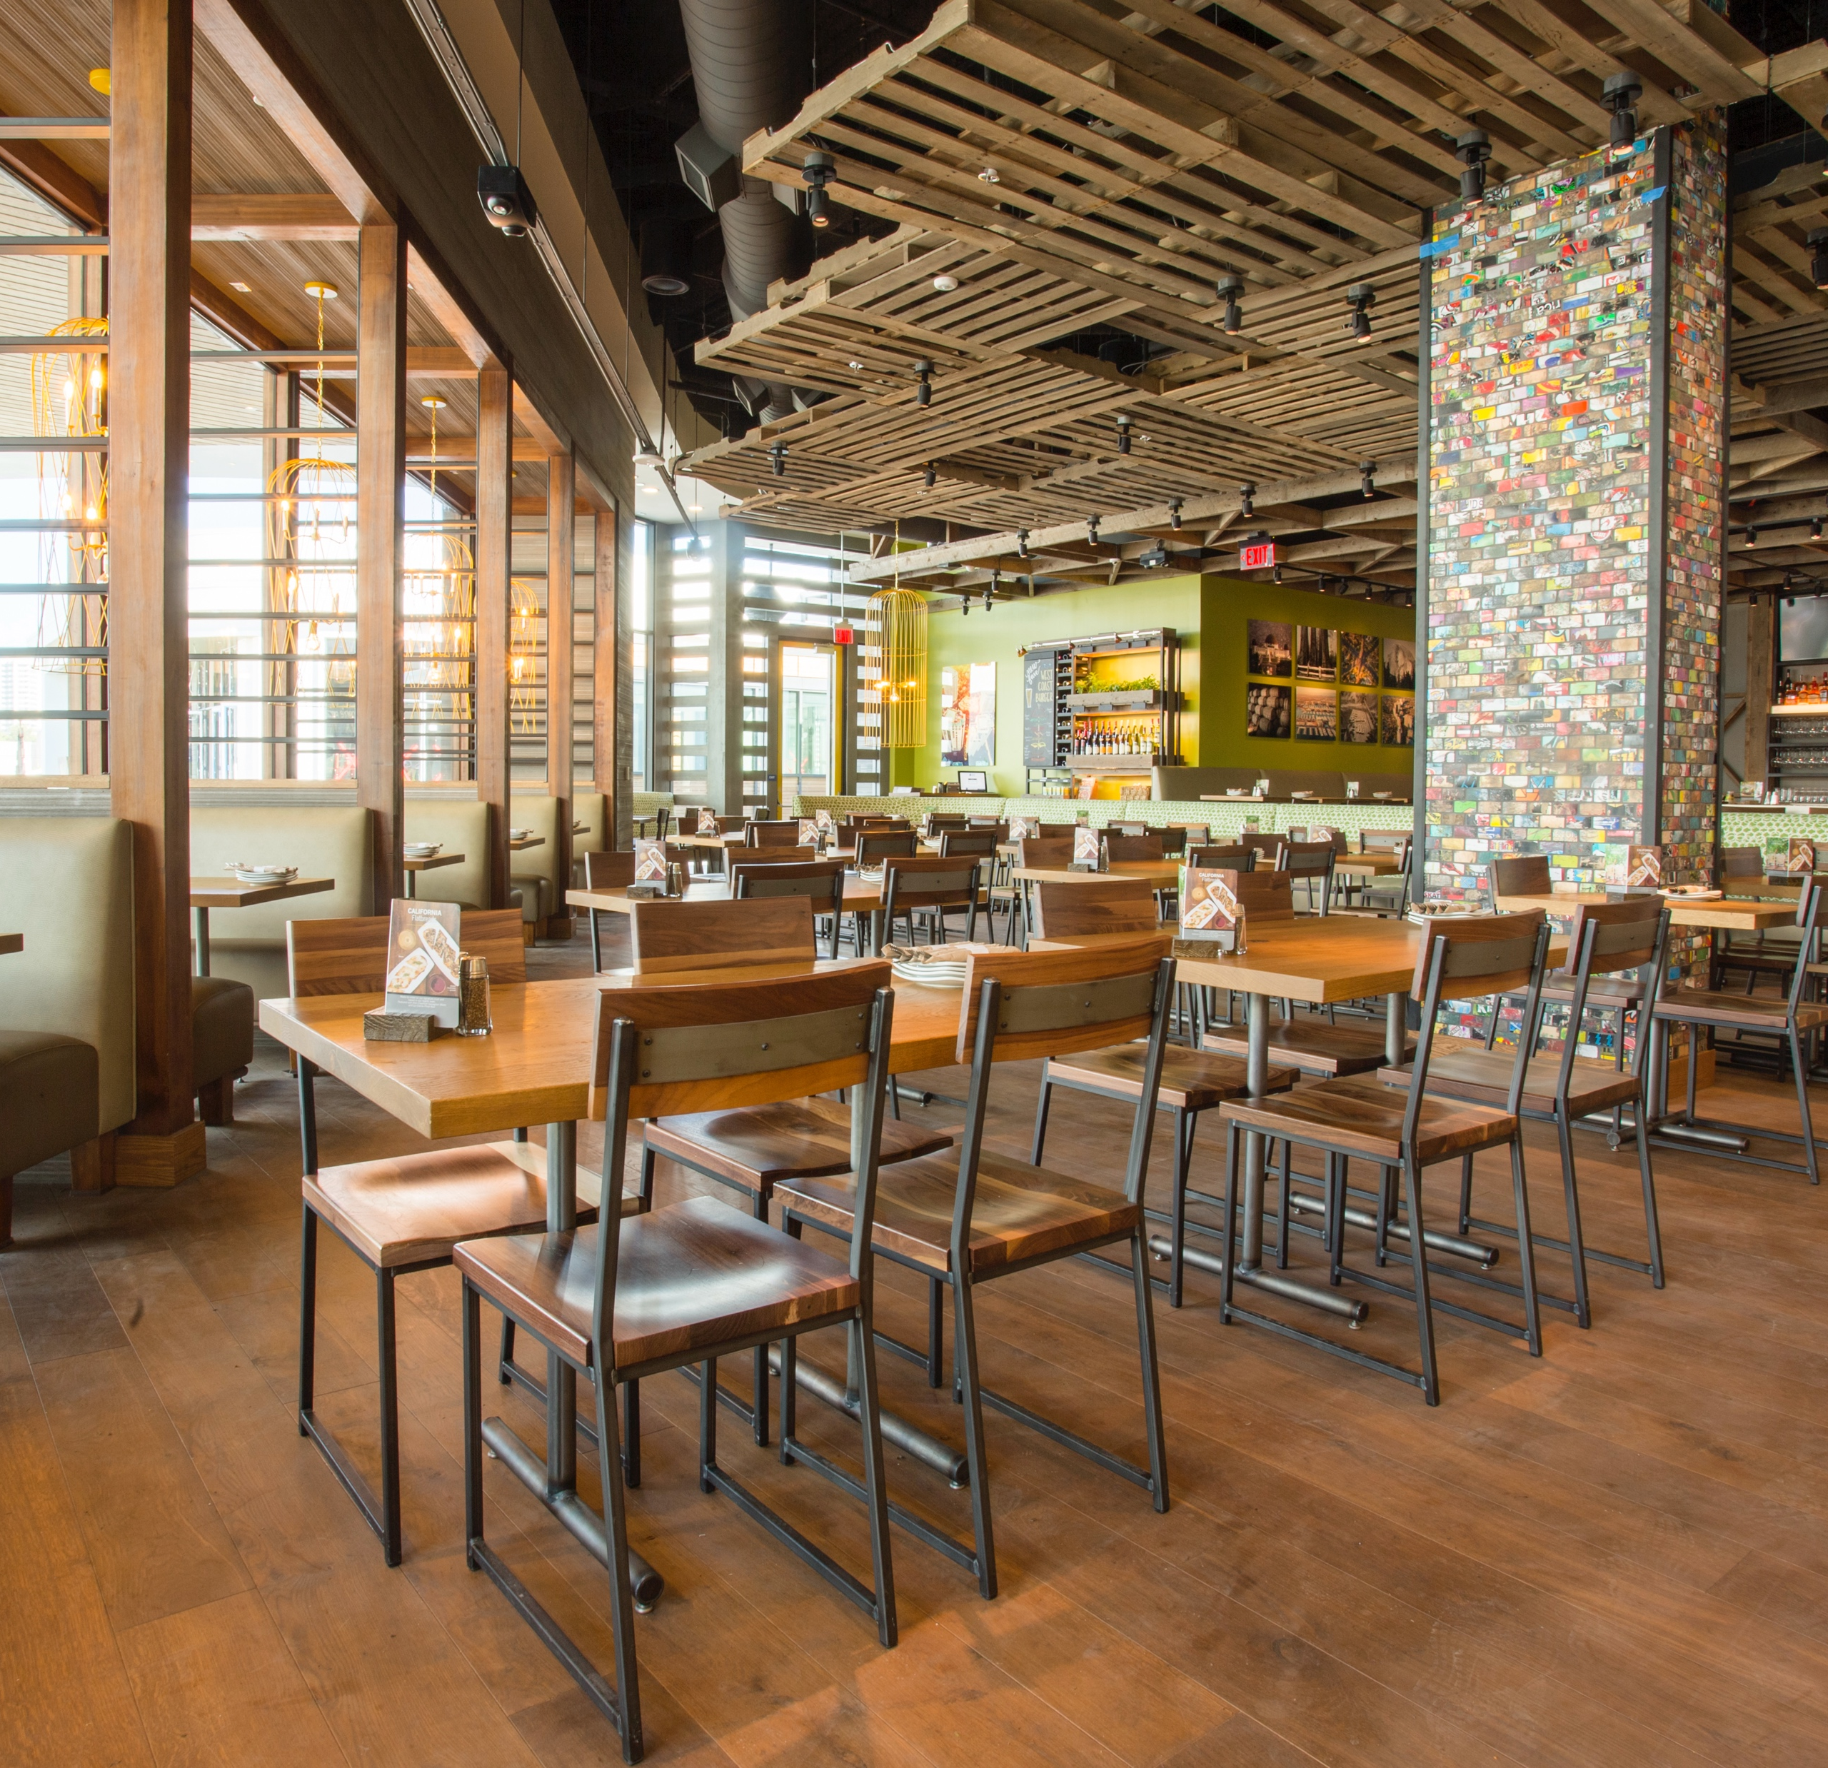
OUR FRANCHISE OFFER FOR 2024

Slide 2
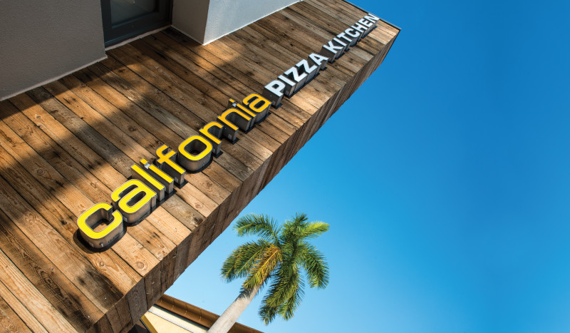
A CATEGORY OF ONE
“We have the authority to own a lucrative white space no other brand can claim"

Slide 3
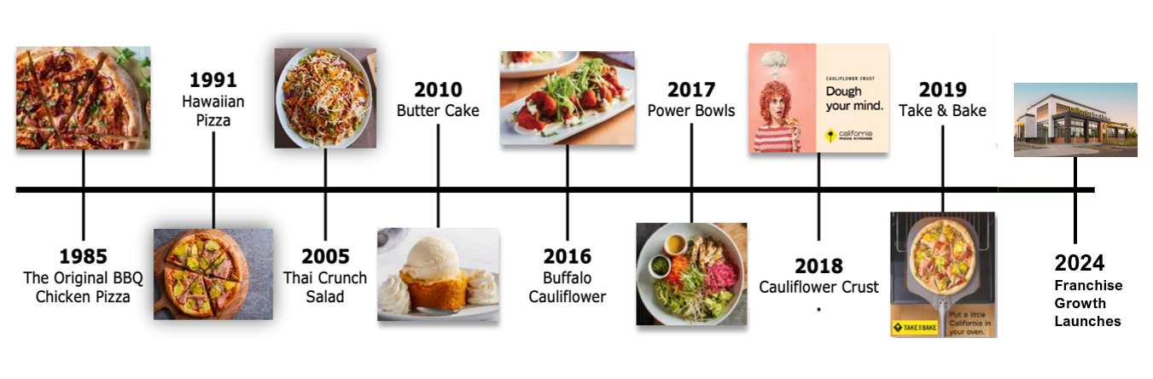
CALIFORNIA FORWARD WITH A HISTORY OF INNOVATION

Slide 4
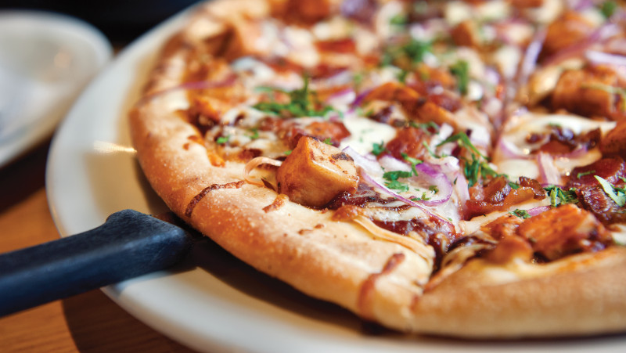
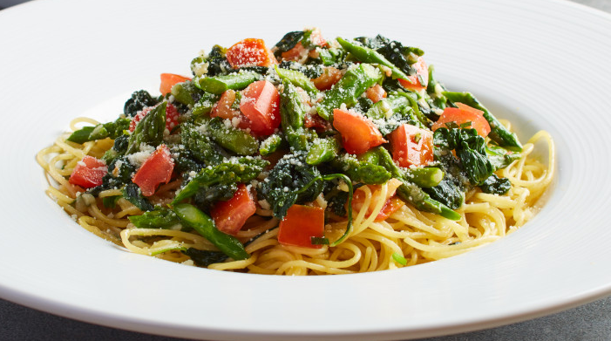
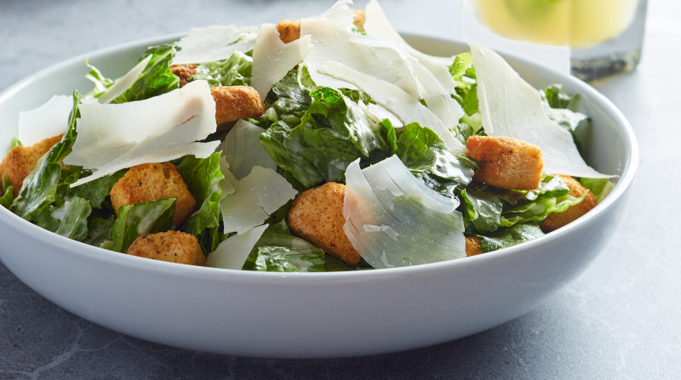
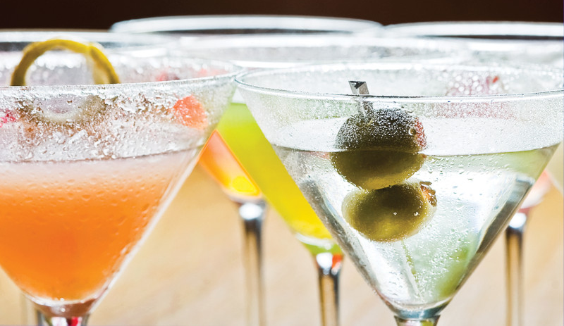
APPETIZERS, PIZZA, PASTAS, SALADS, COCKTAILS & MORE

Slide 5
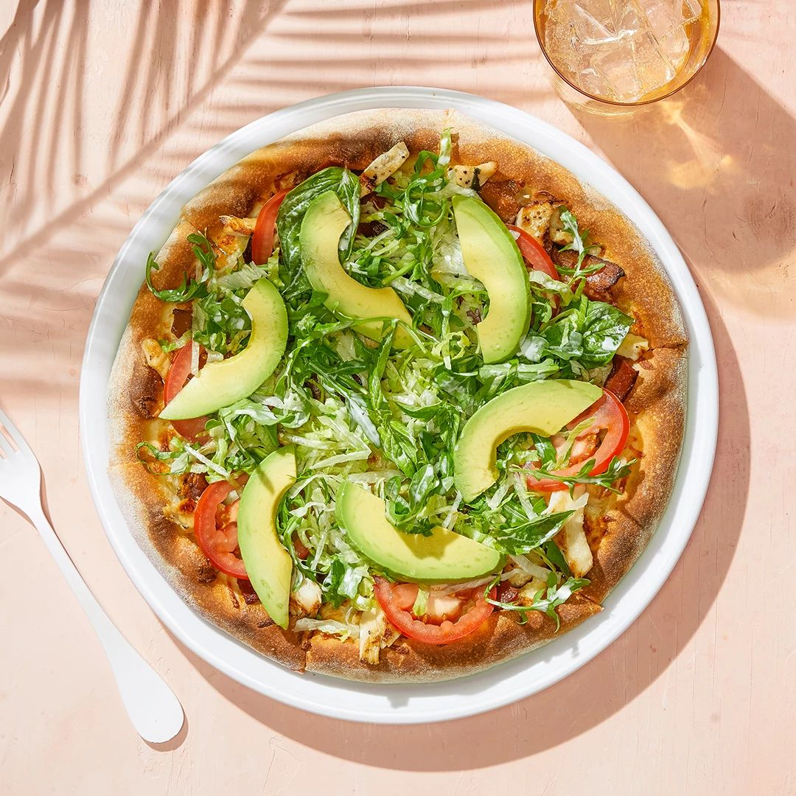

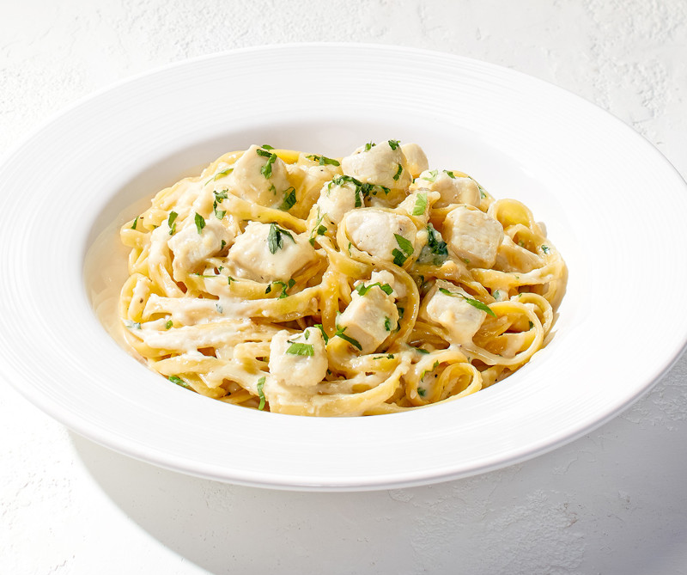
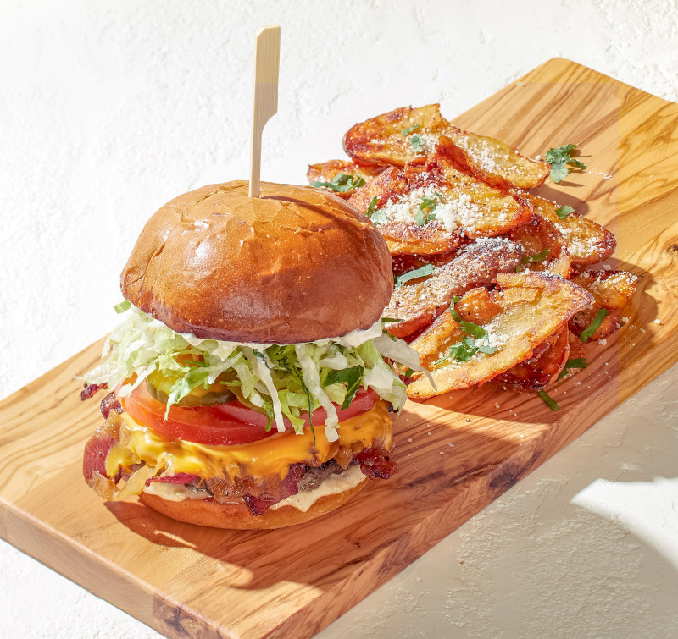
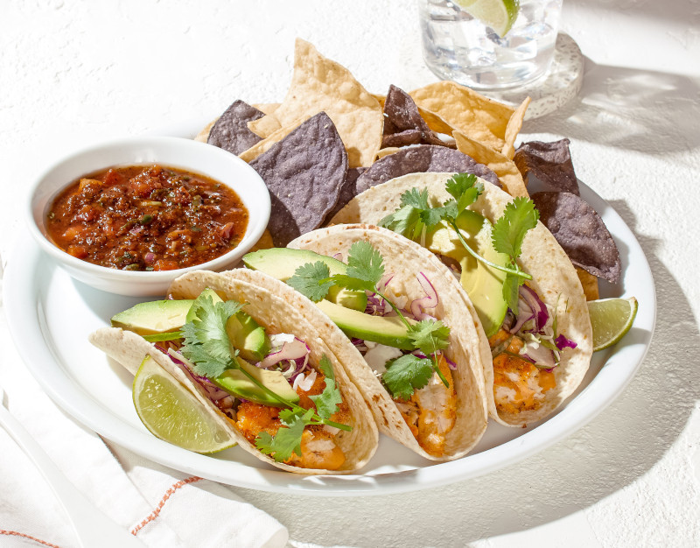
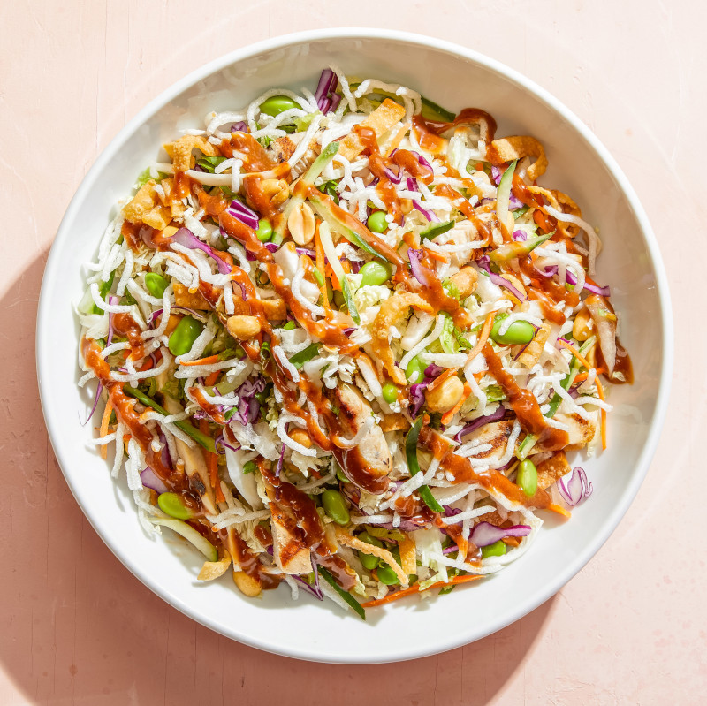
CALI-FRESH FOOD

Slide 6
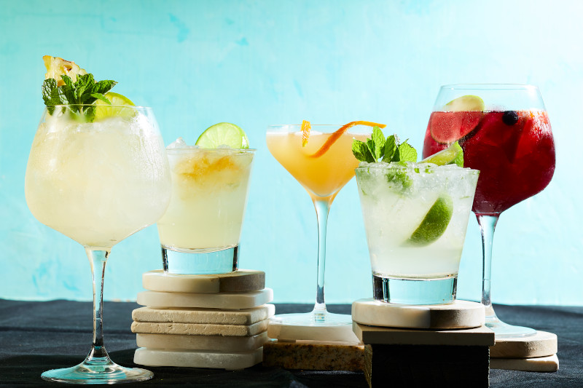
COCKTAILS

Slide 7
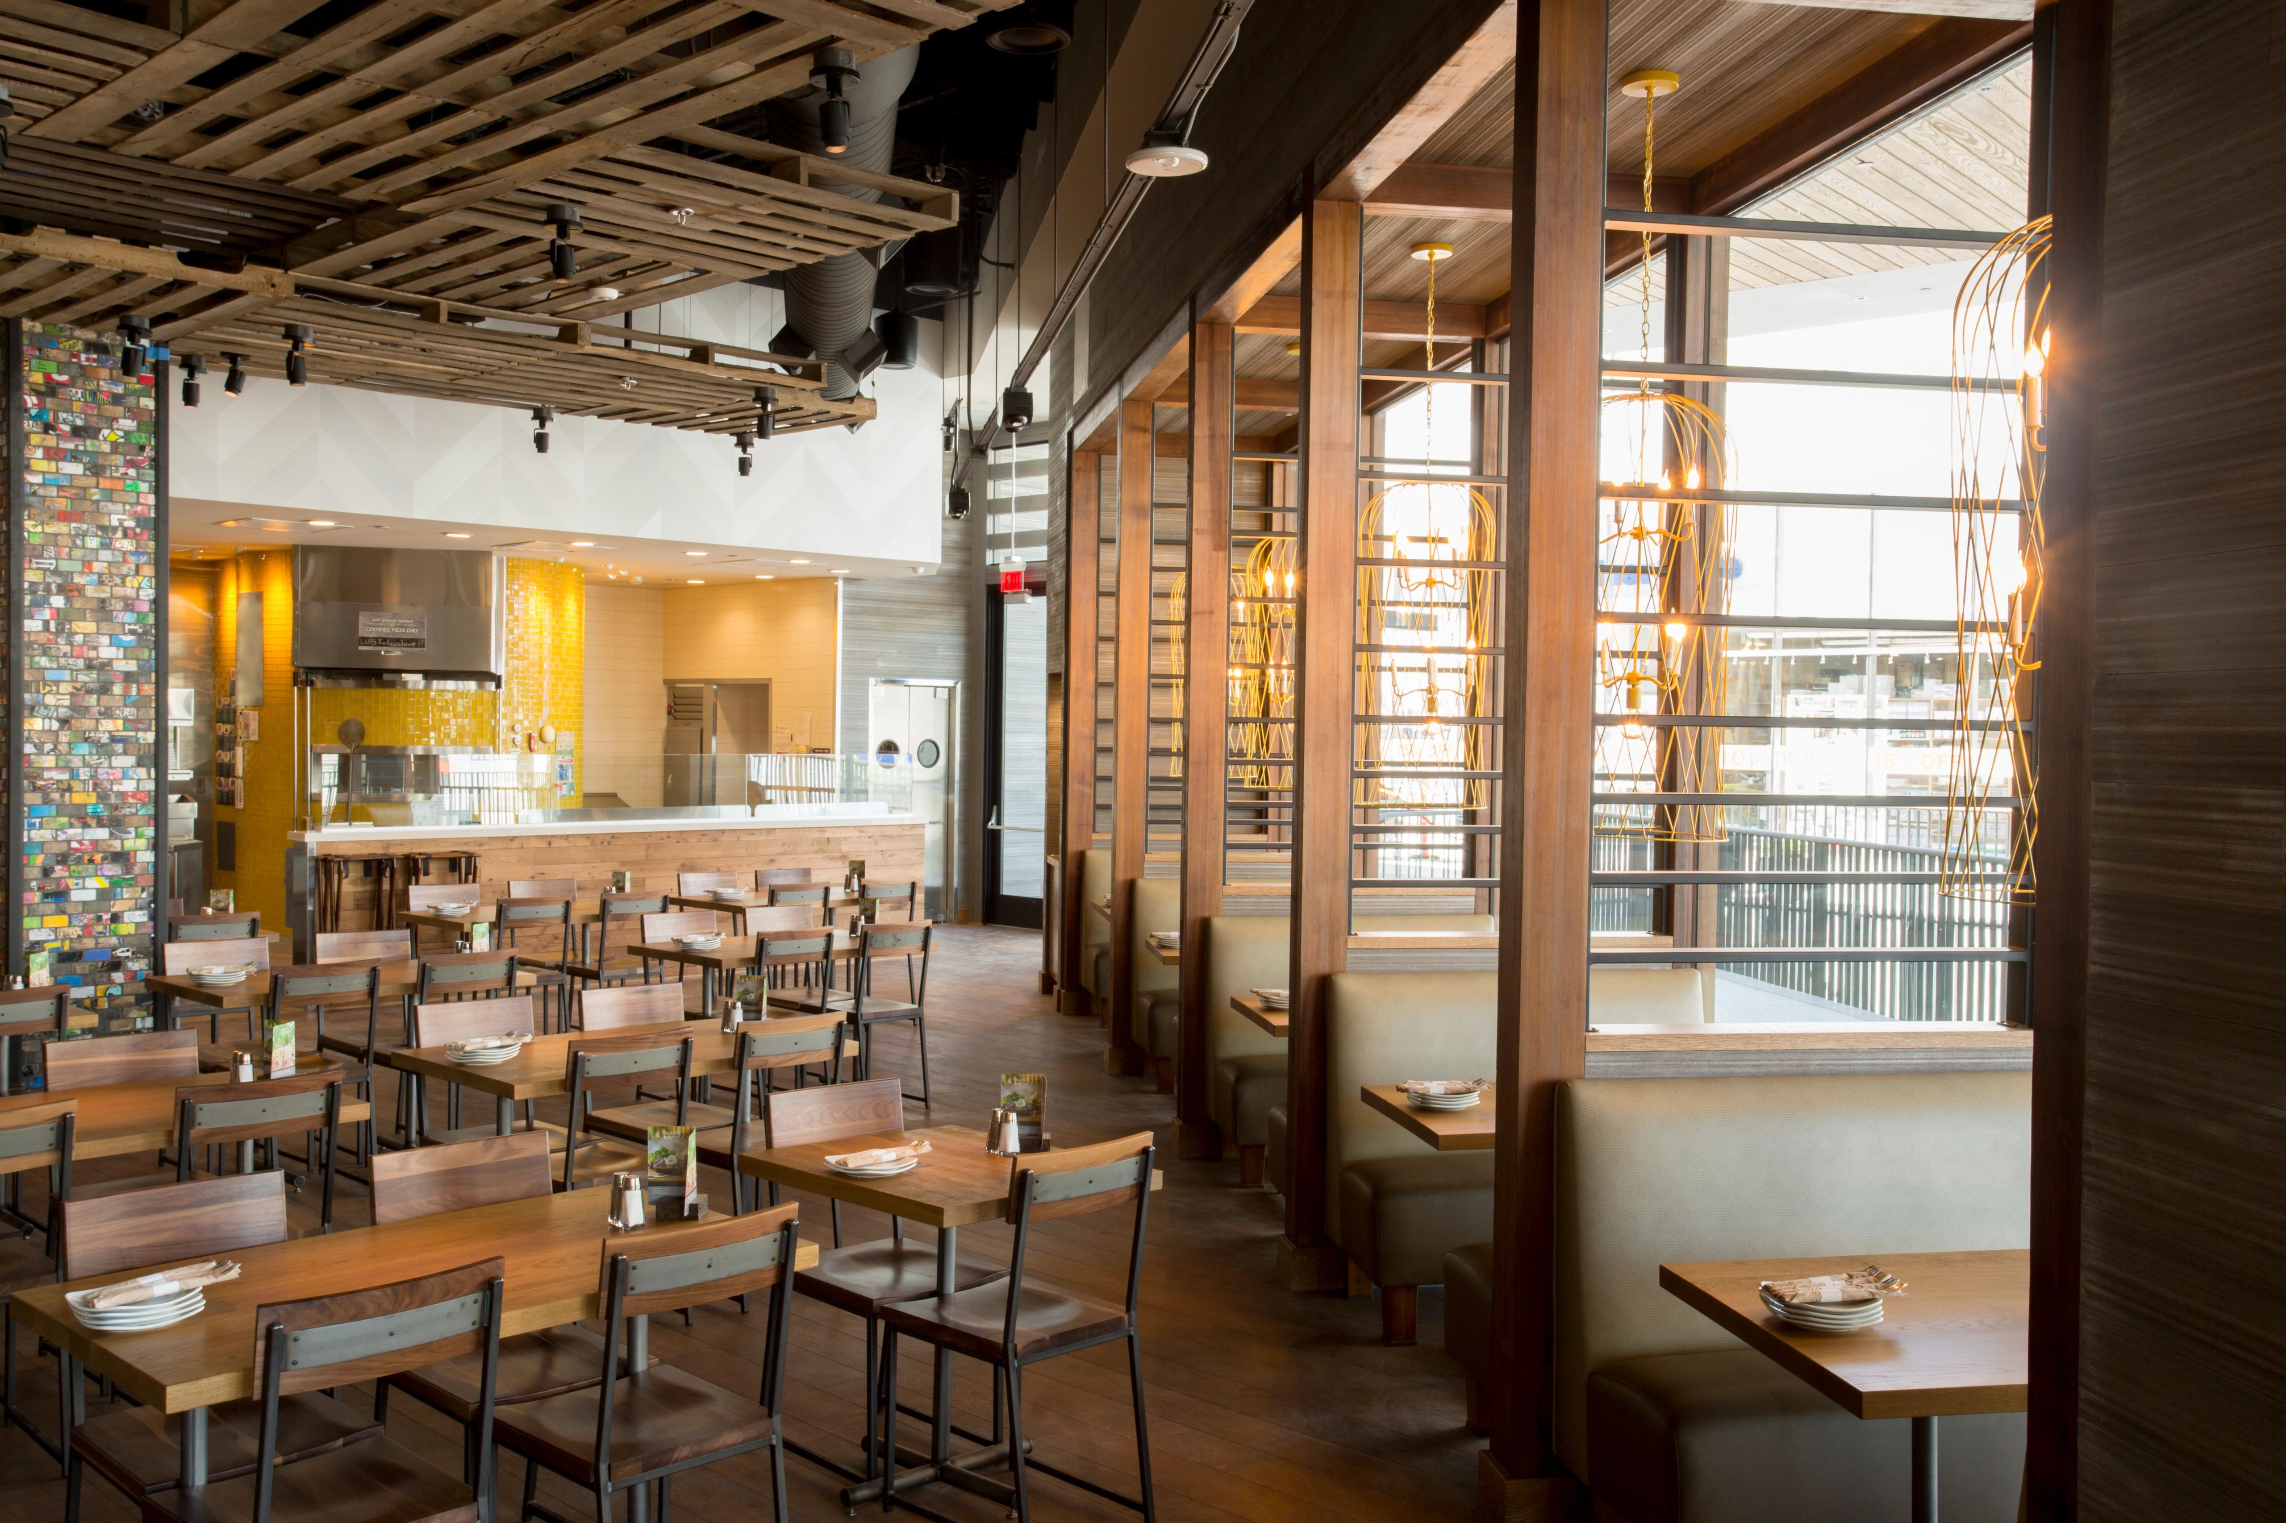
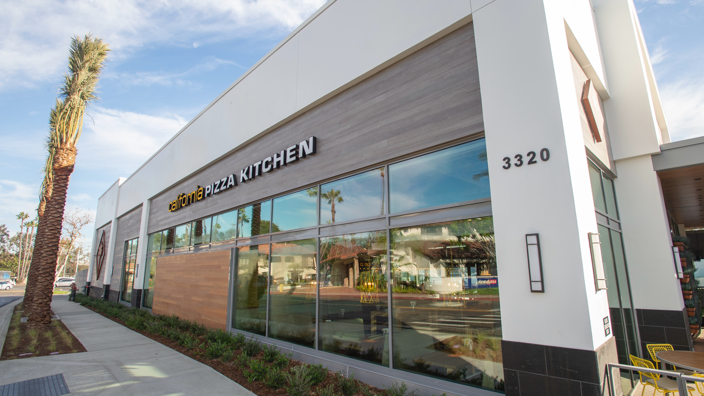
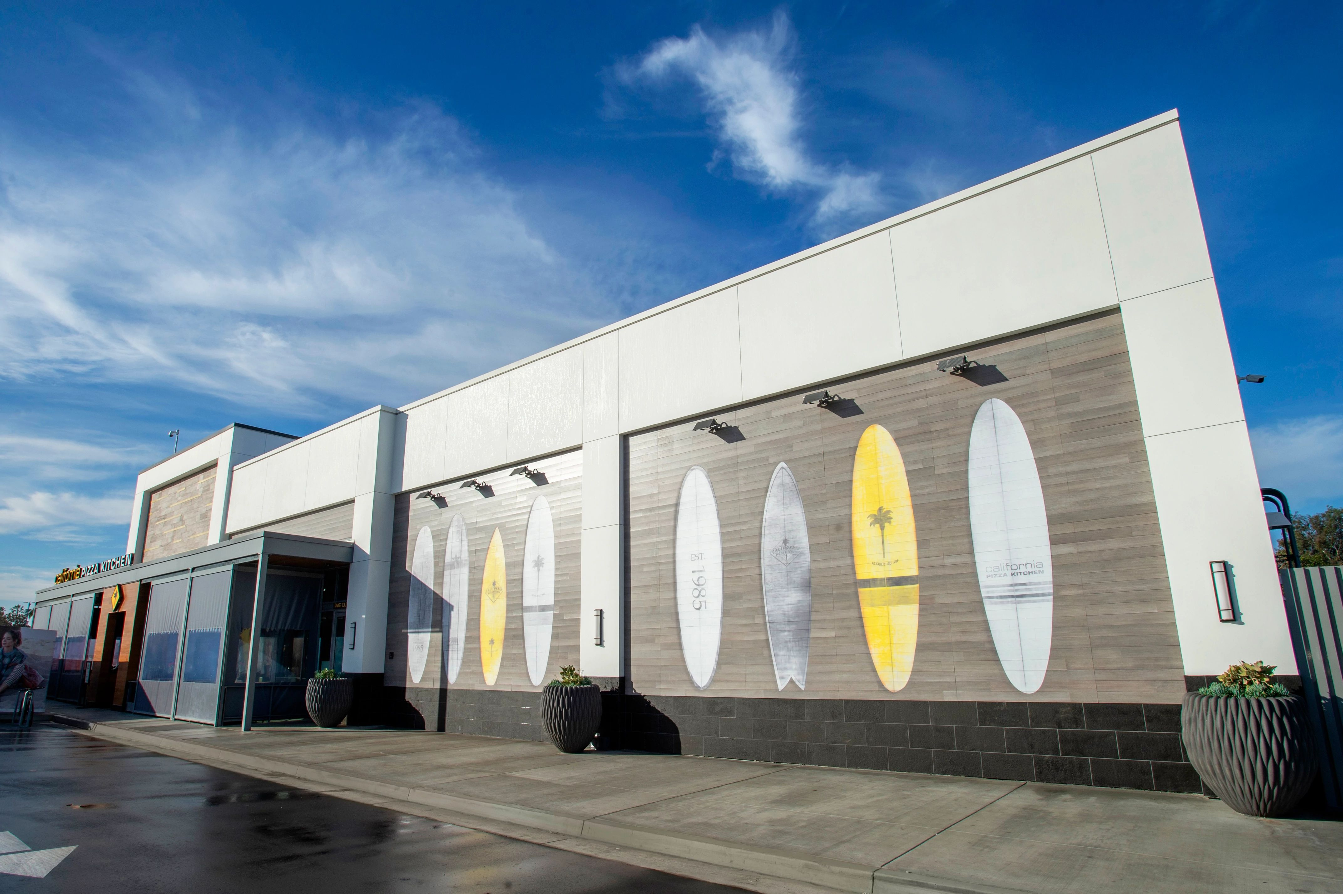
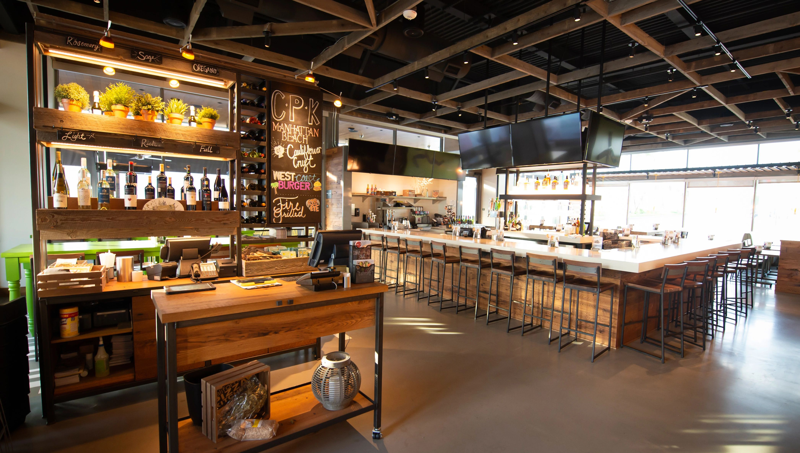
CALIFORNIA MODERN DESIGN

Slide 8
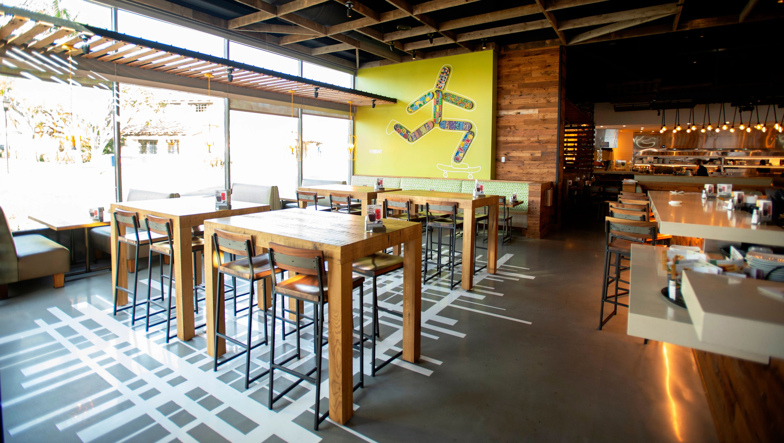
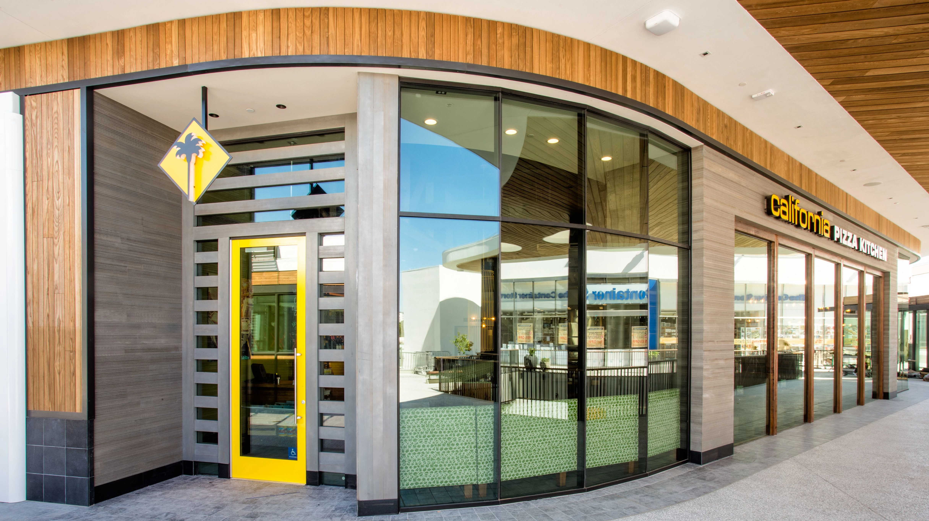
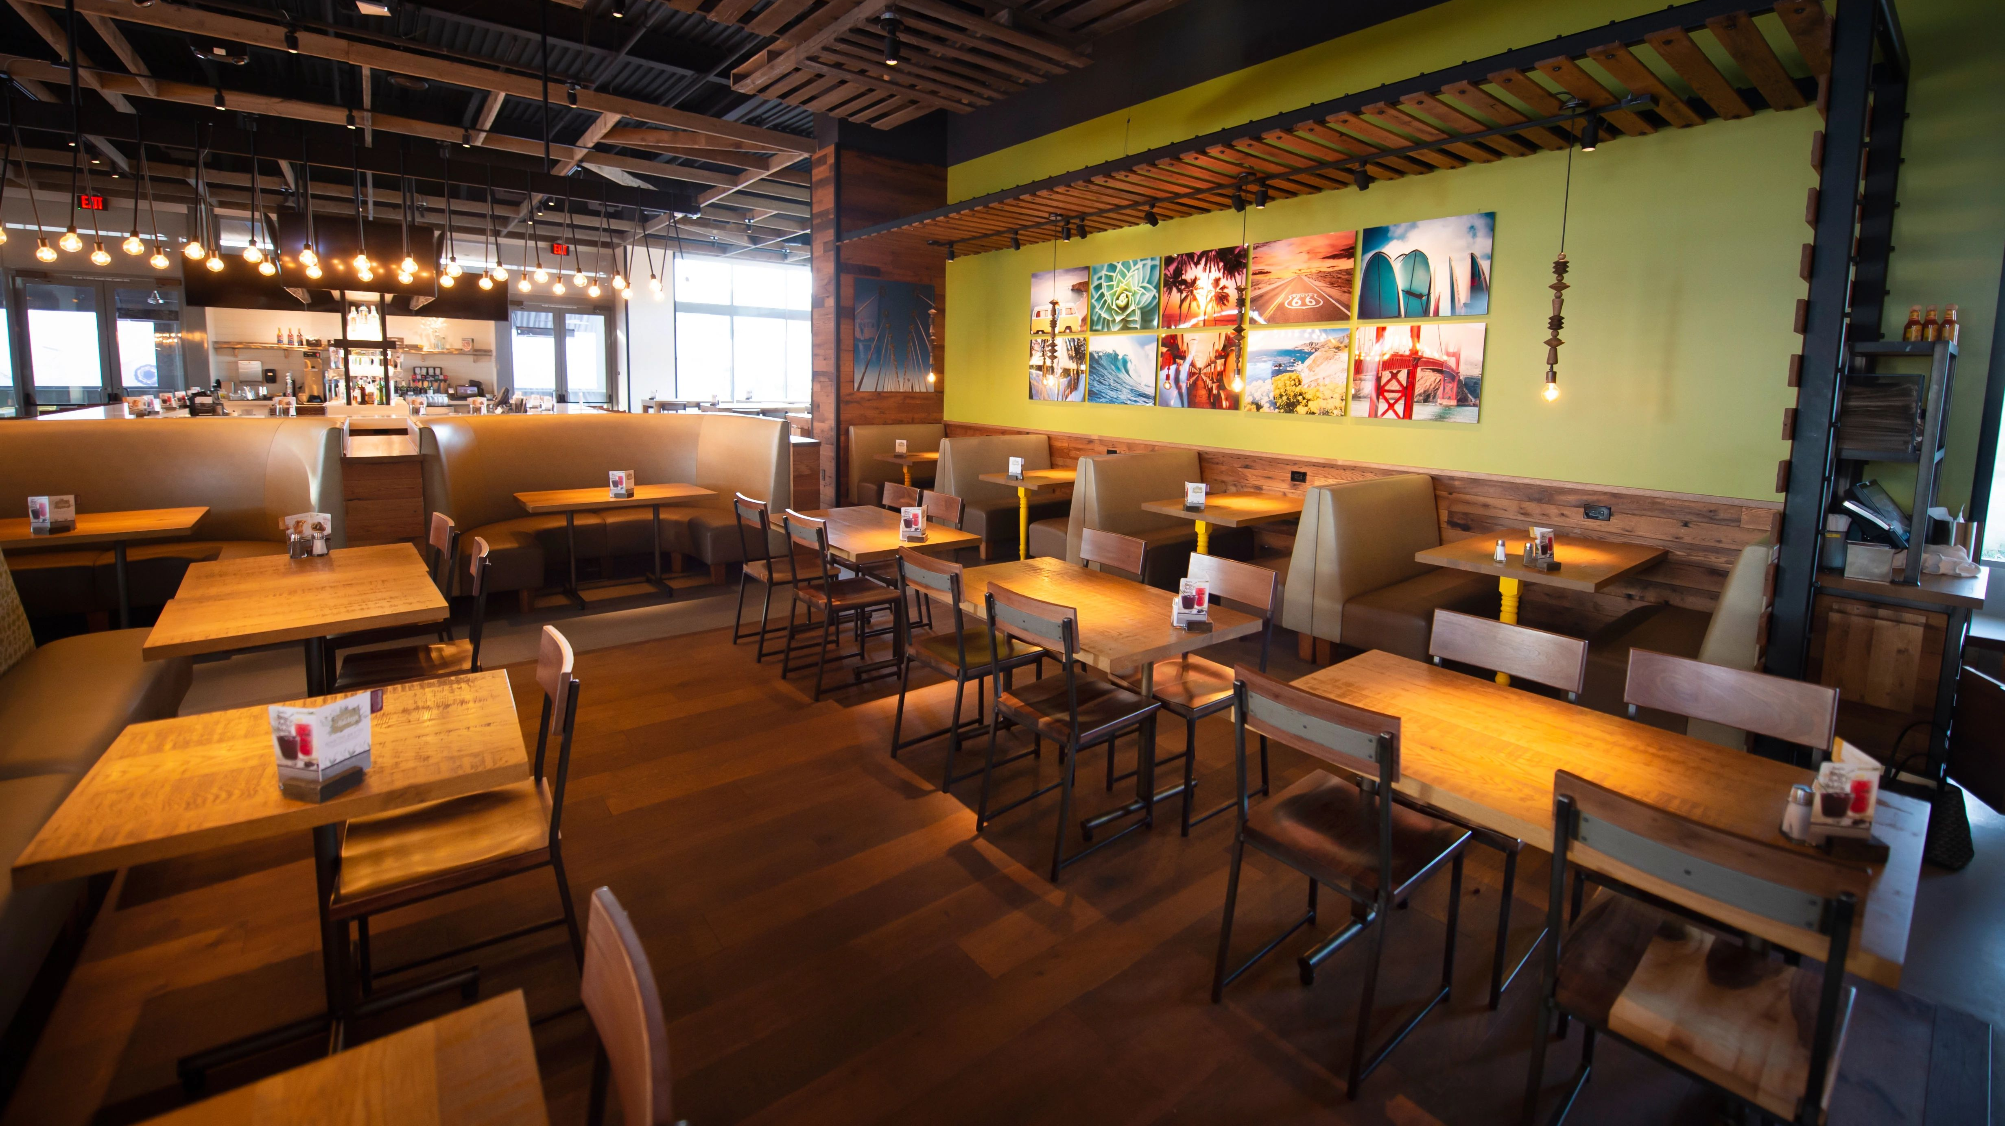
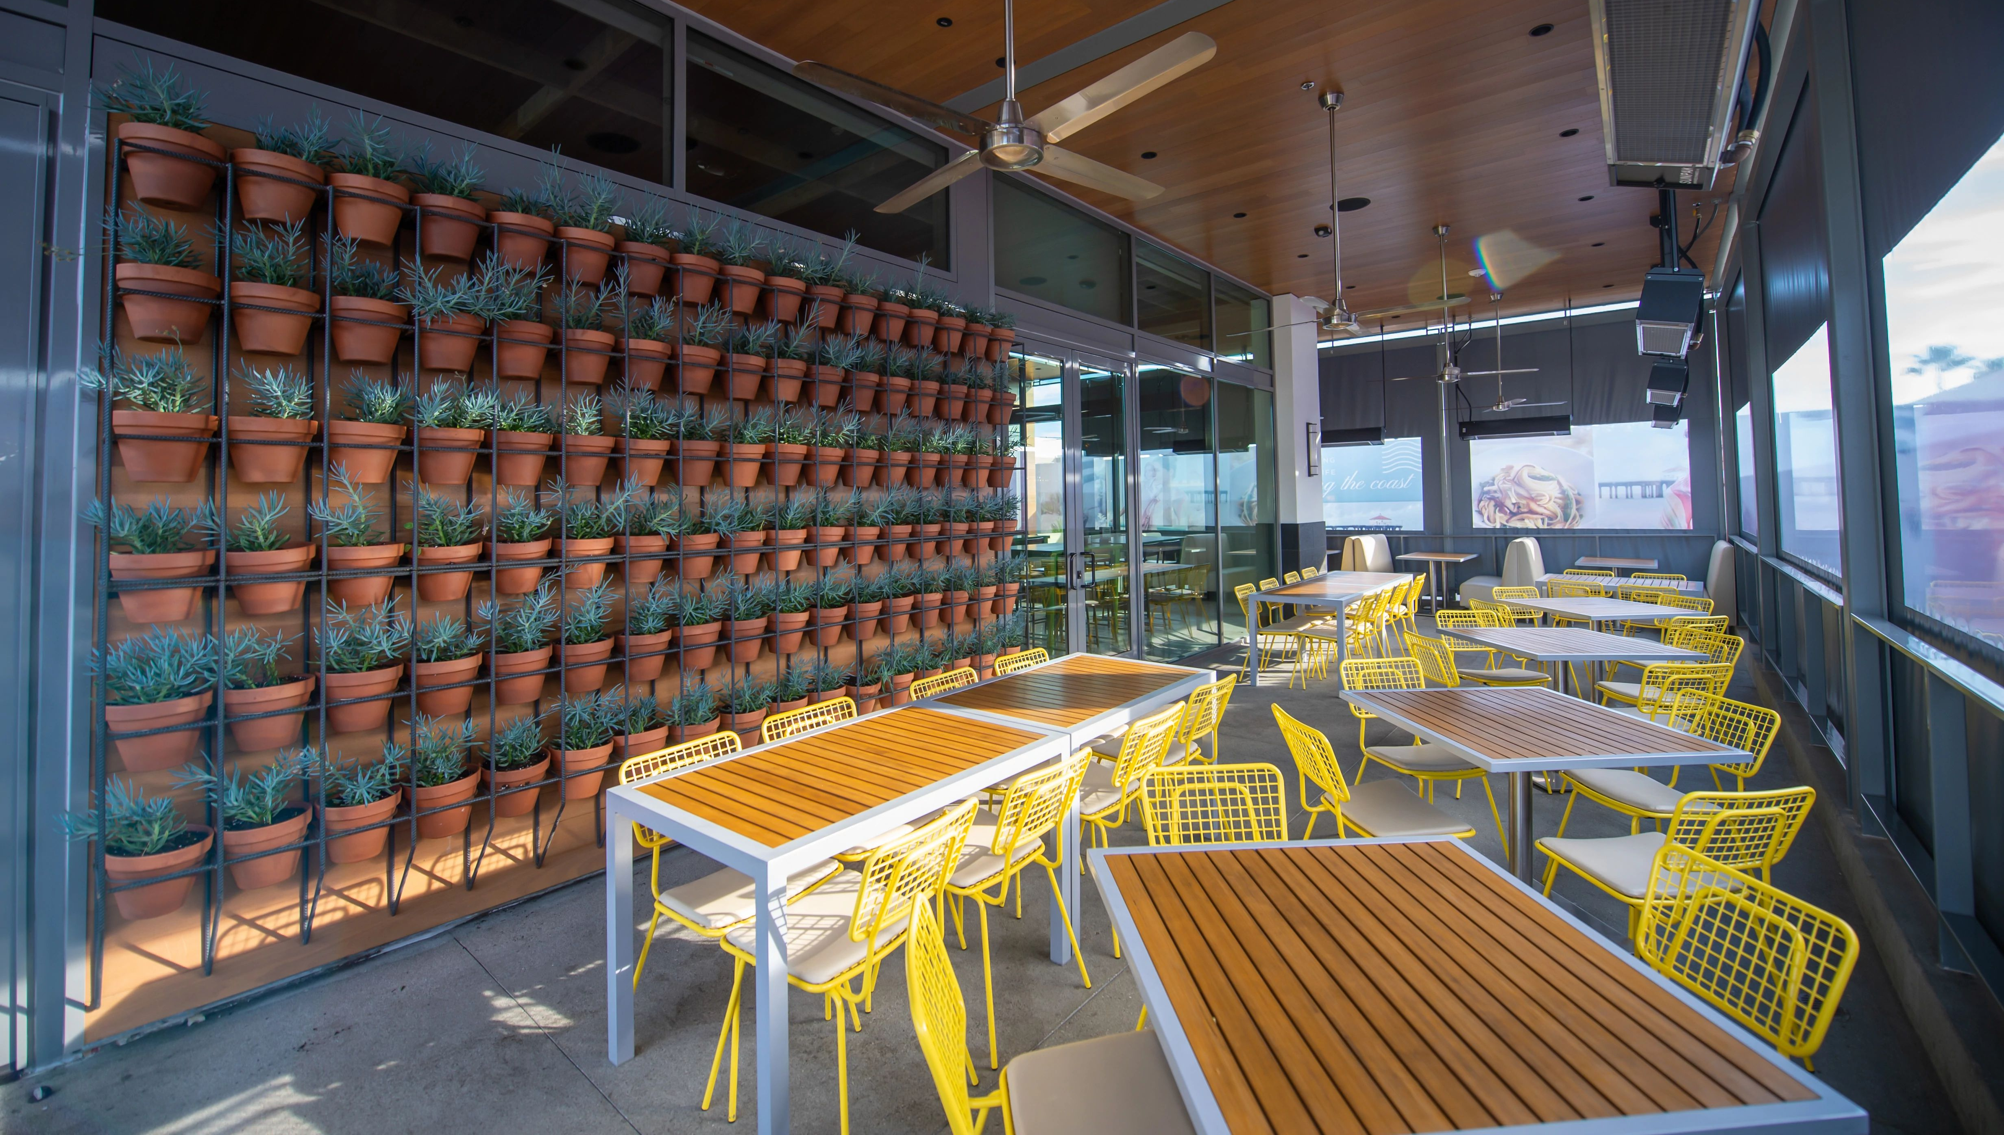
CALIFORNIA MODERN DESIGN

Slide 9

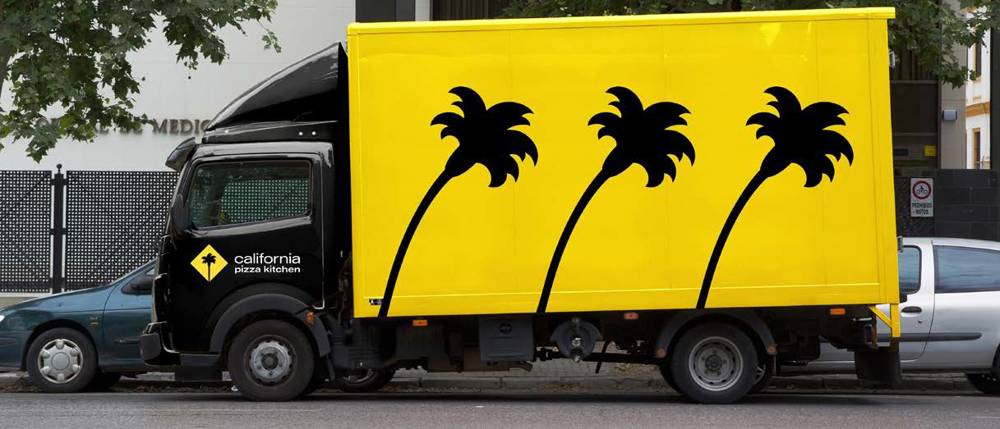
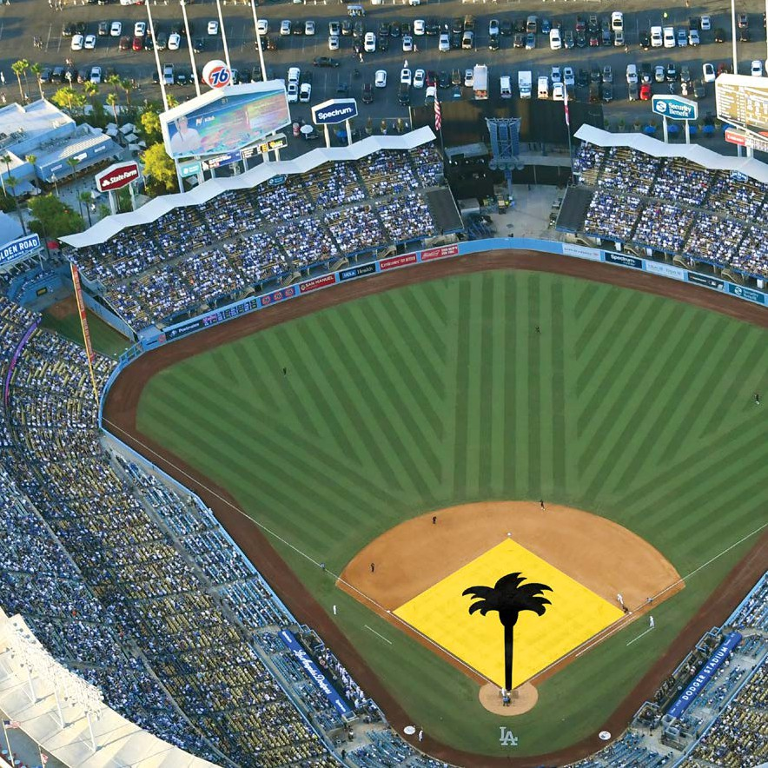
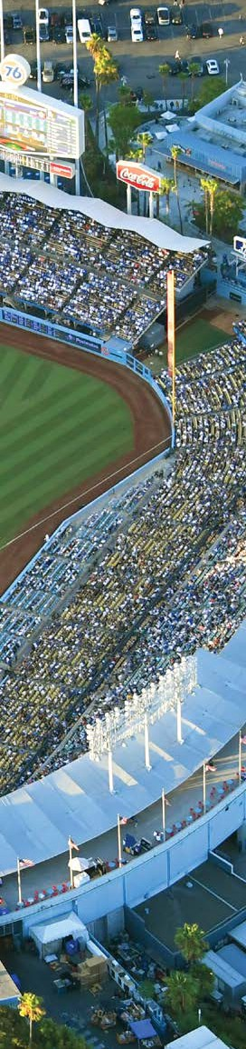
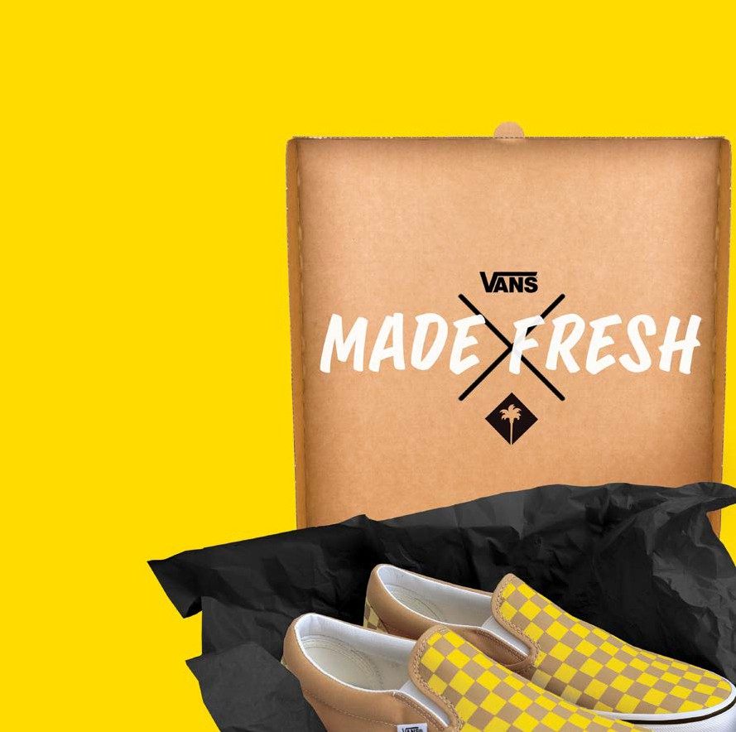


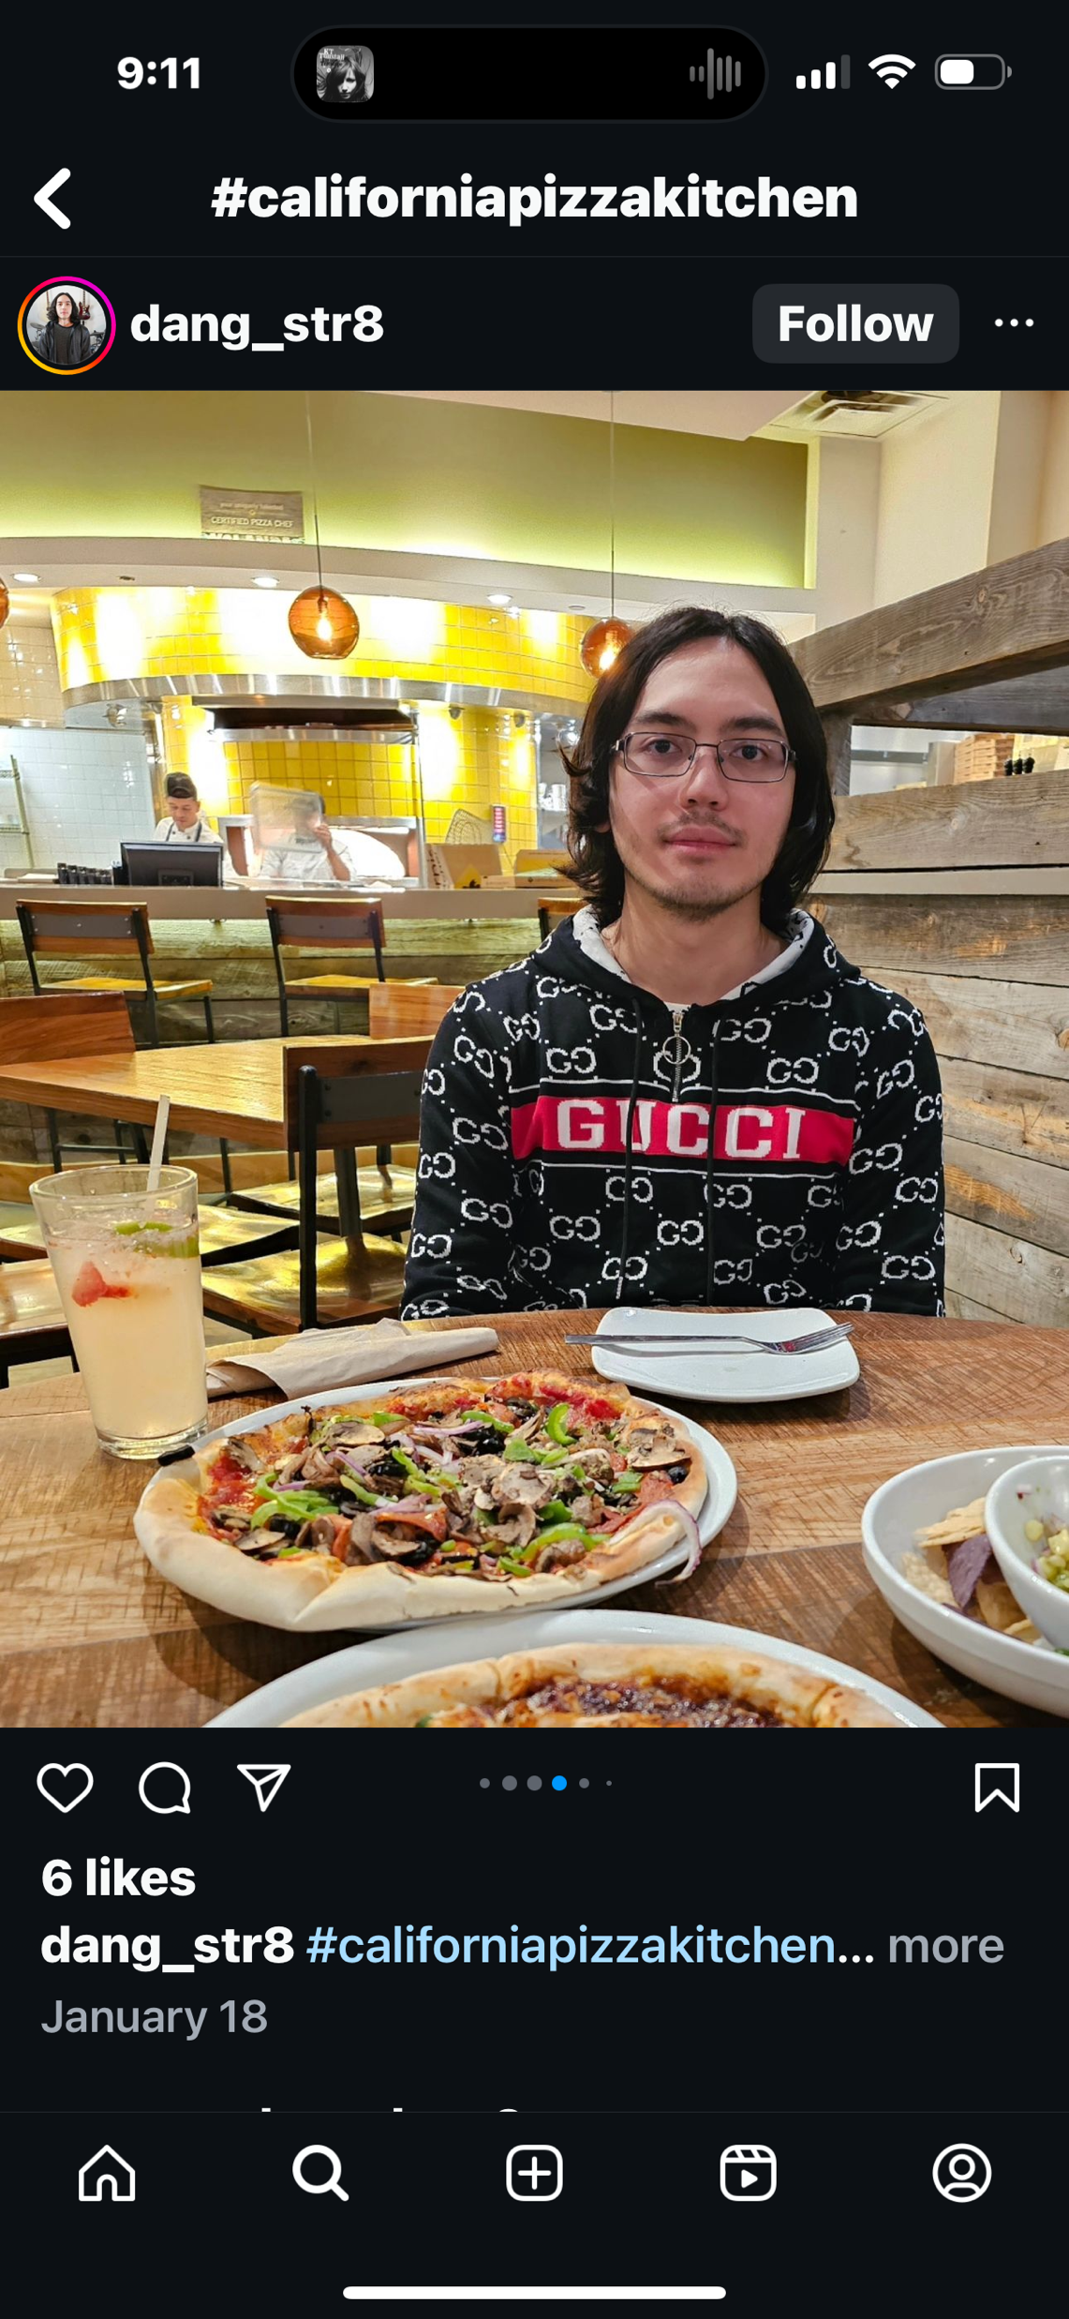
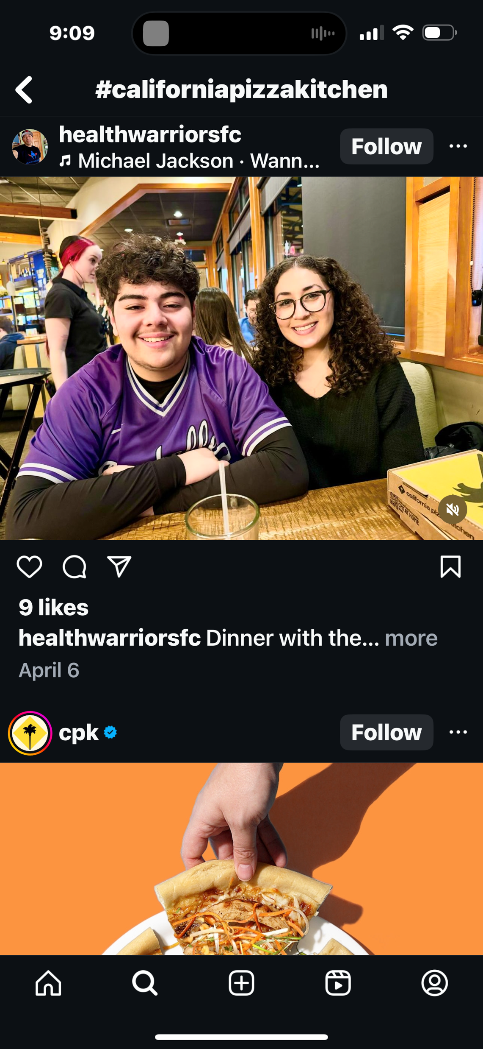
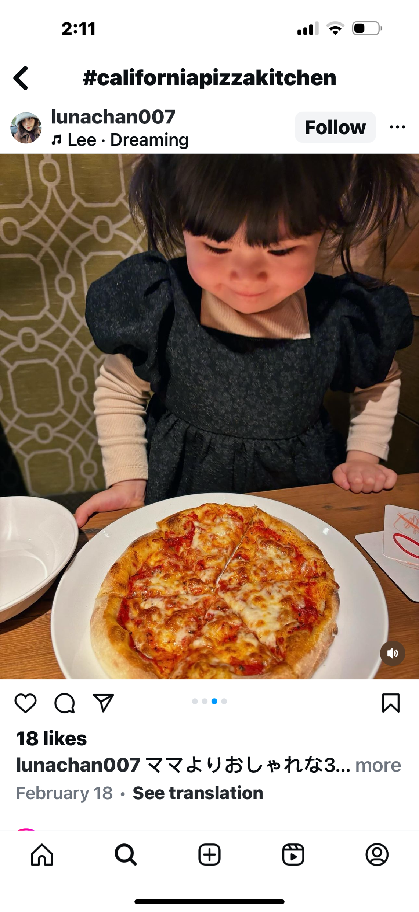
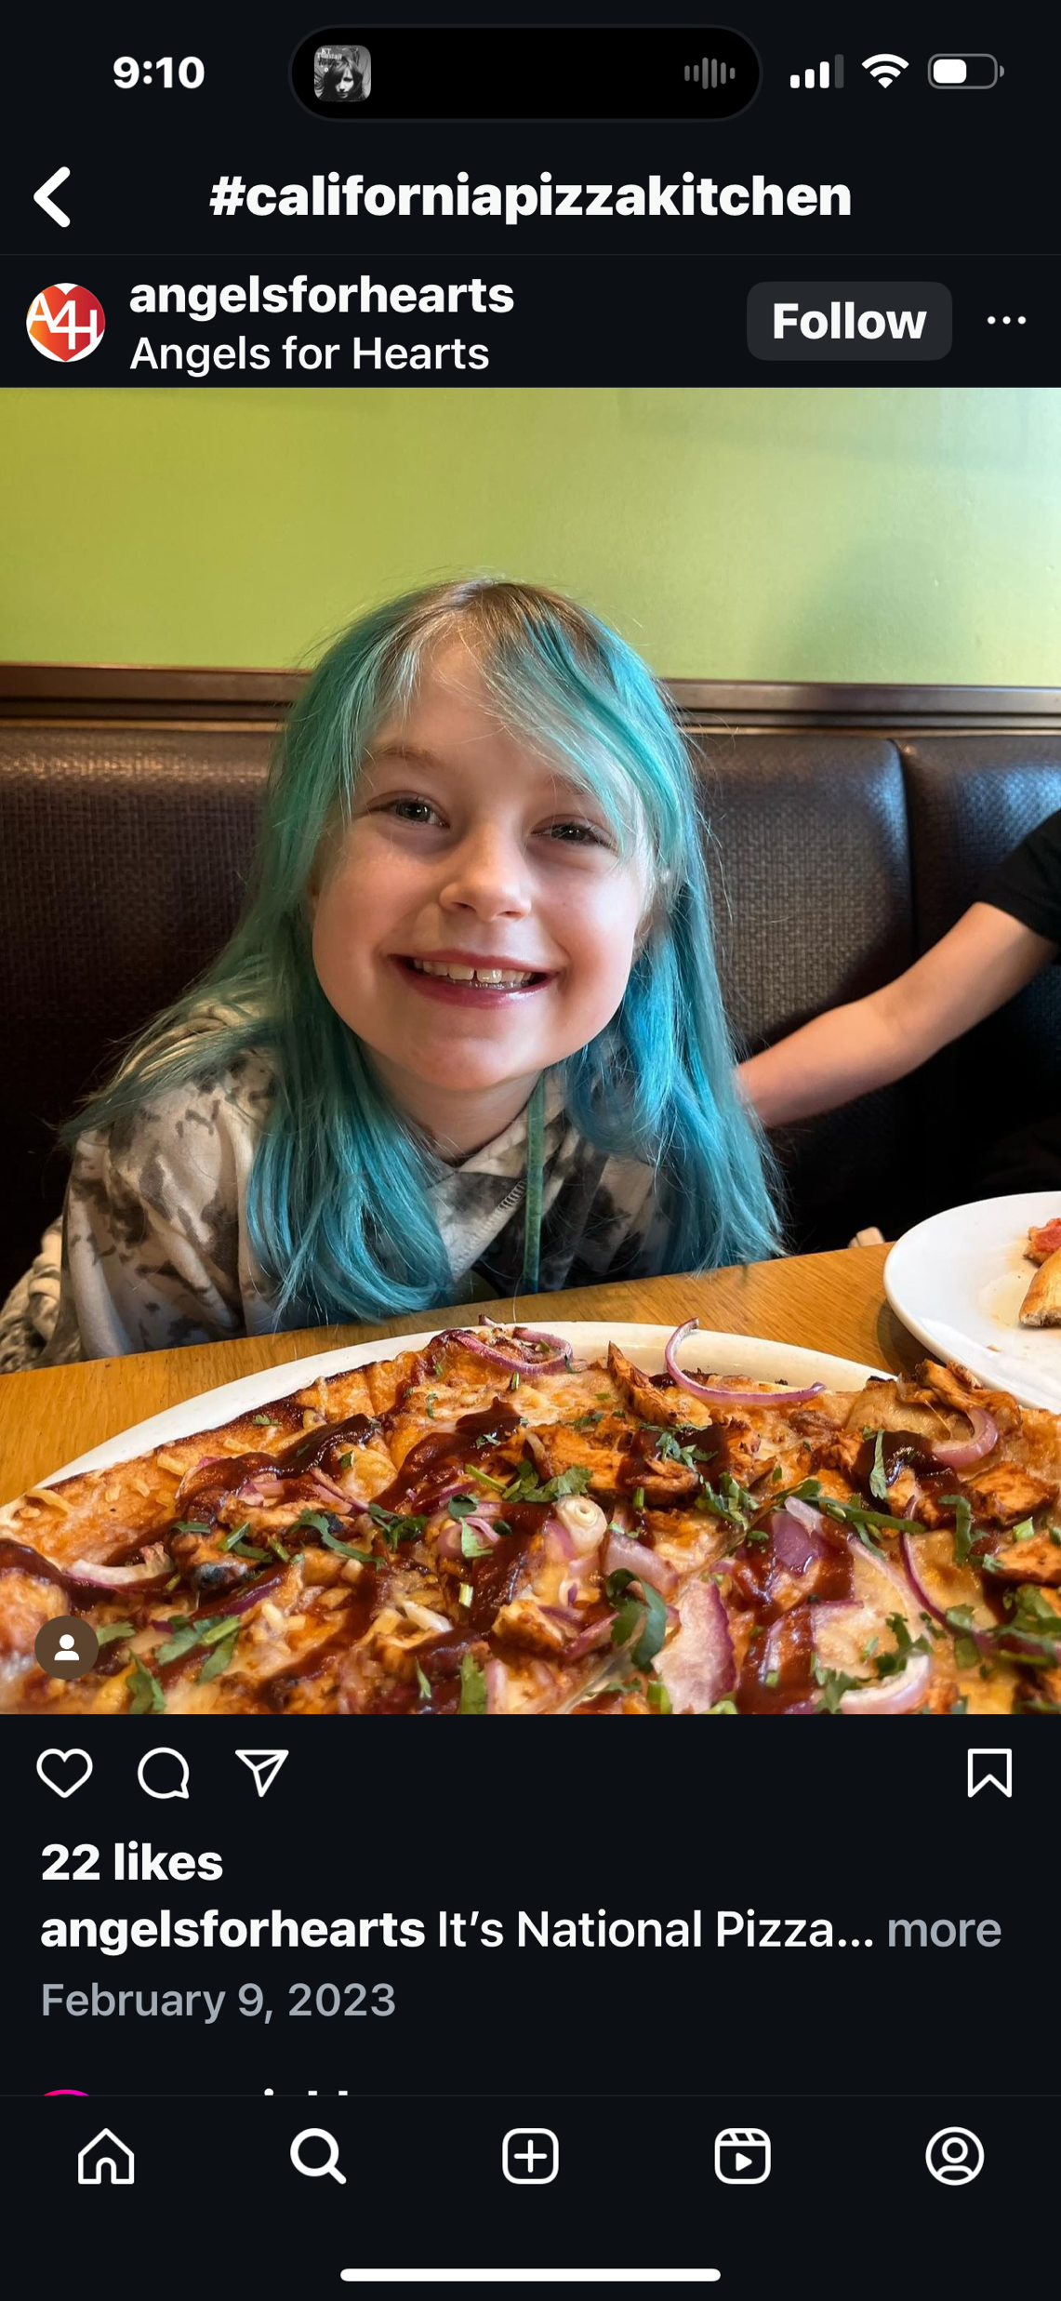
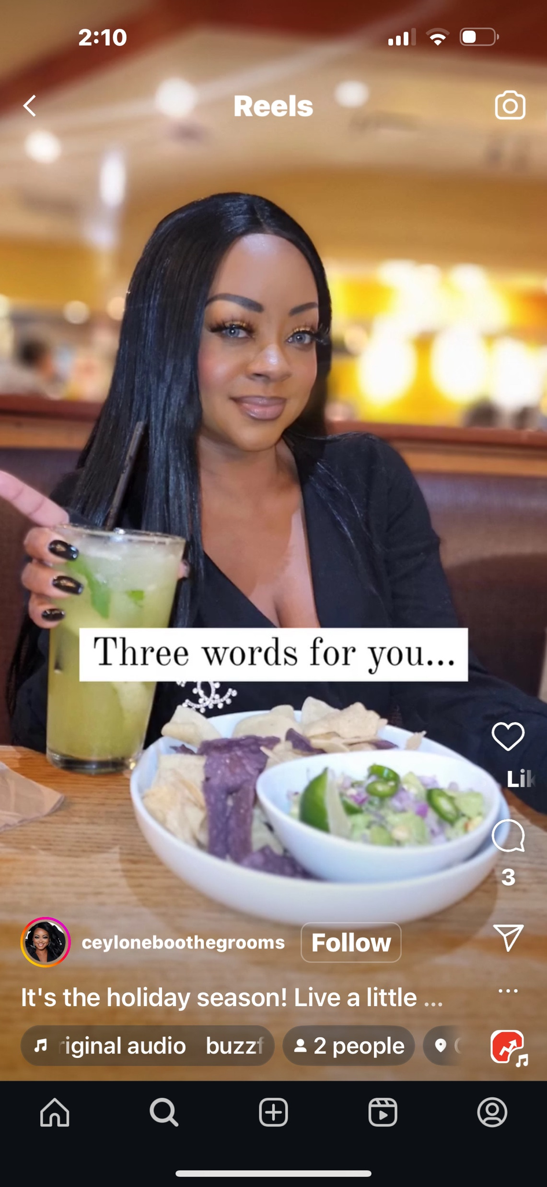

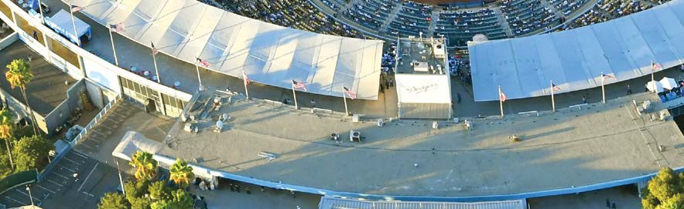


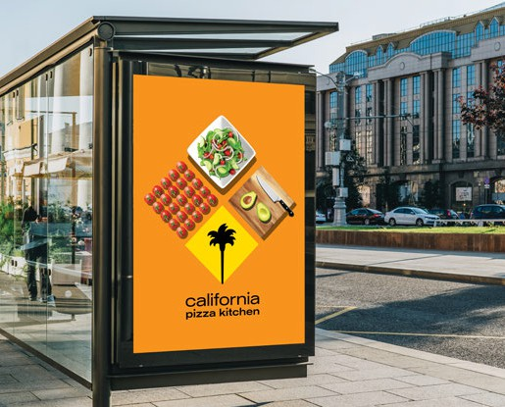



CPK #1 IN BRAND IMAGE
Place I can trust
Excellent reputation
Unique
Innovative

Slide 10
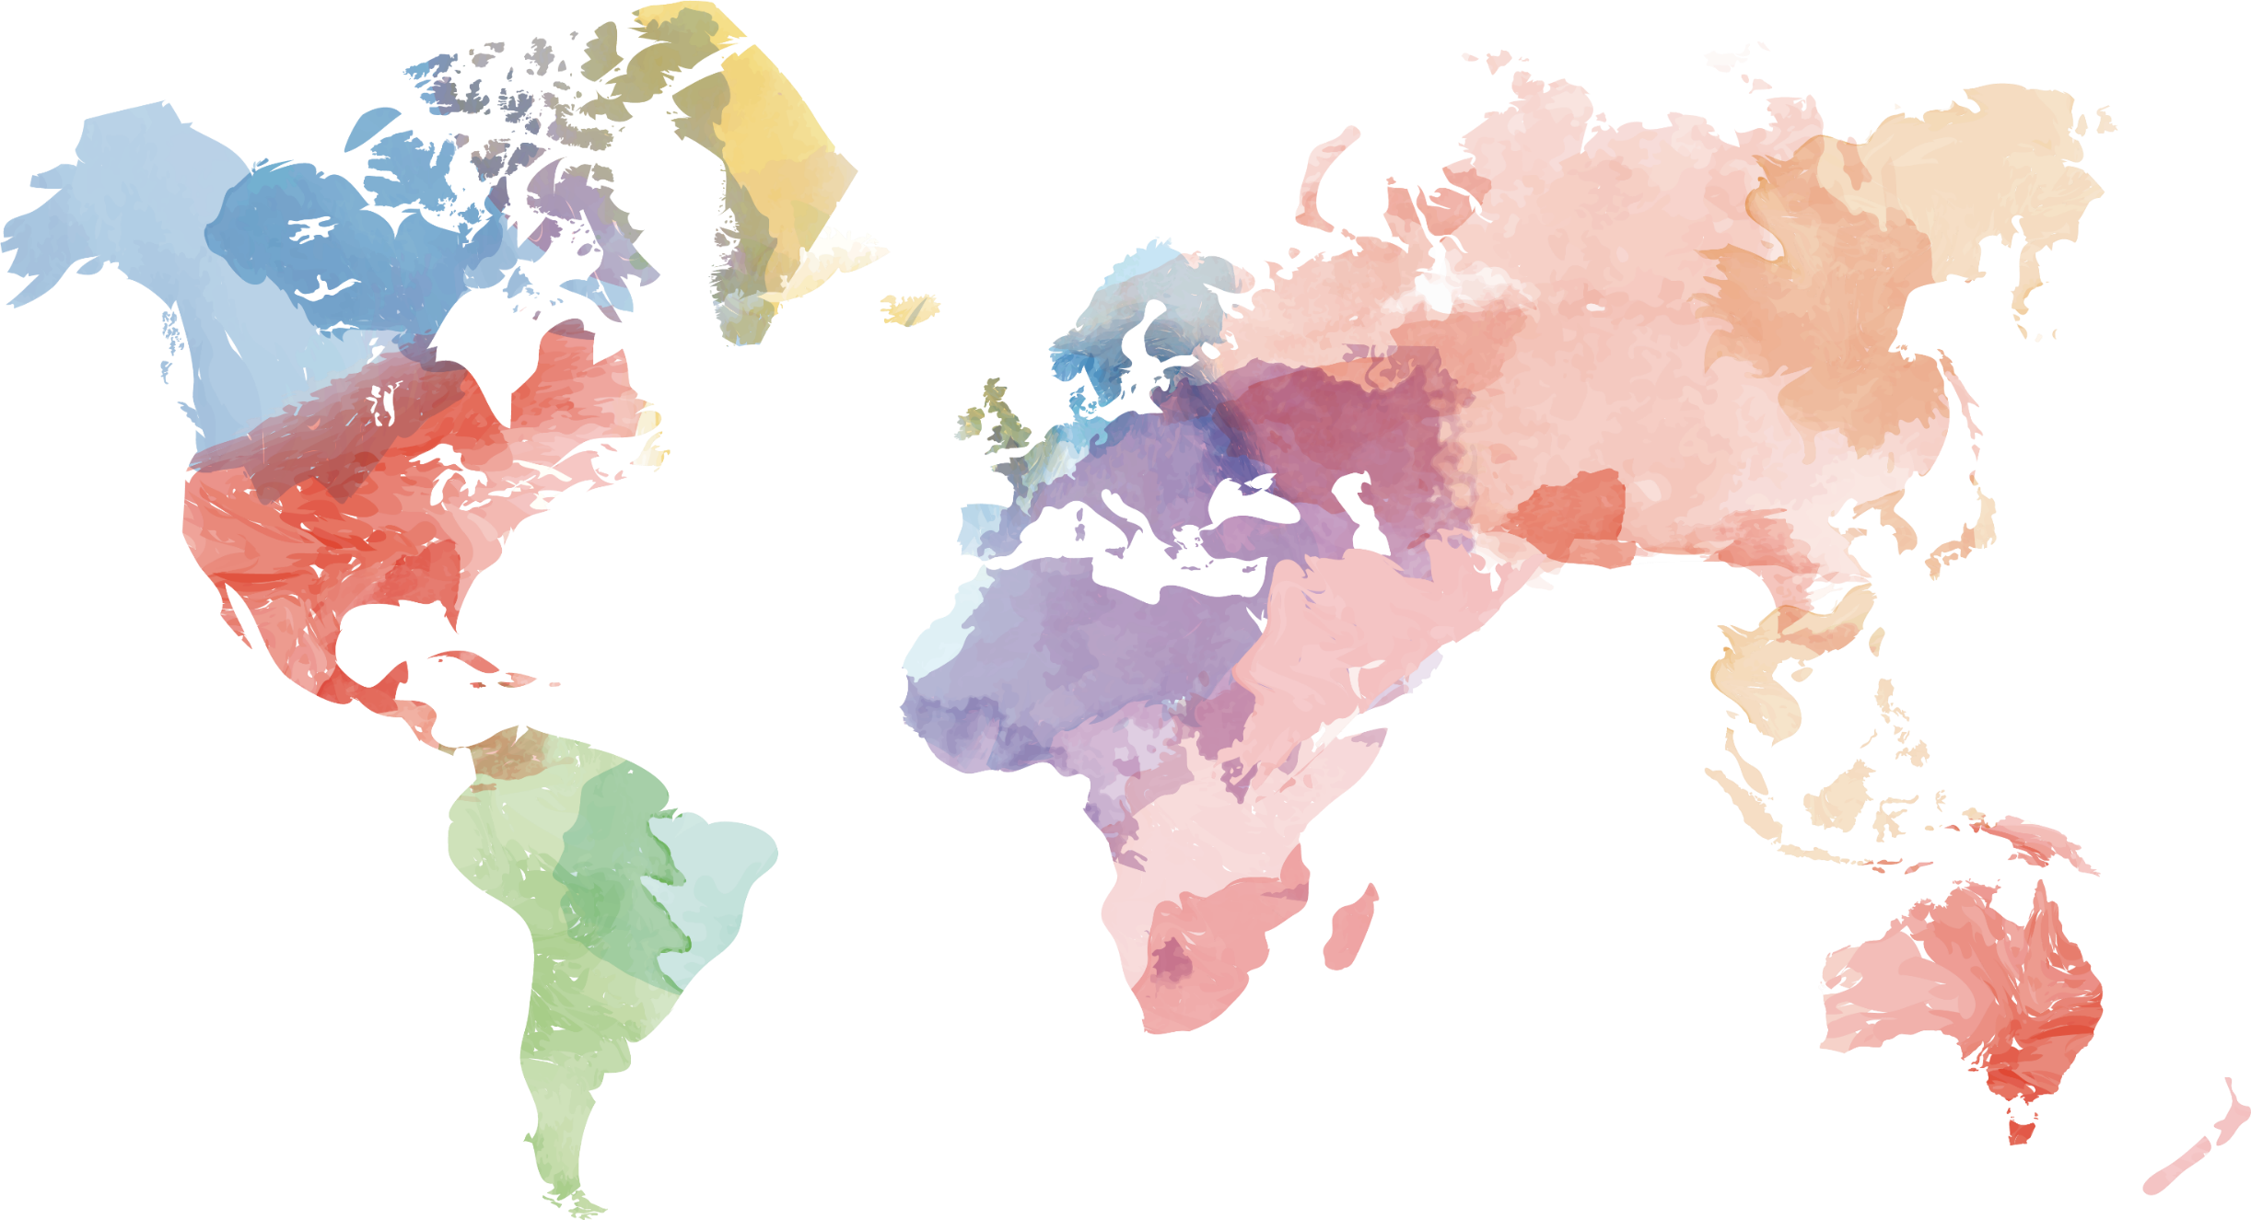
A GLOBAL BRAND

Slide 11
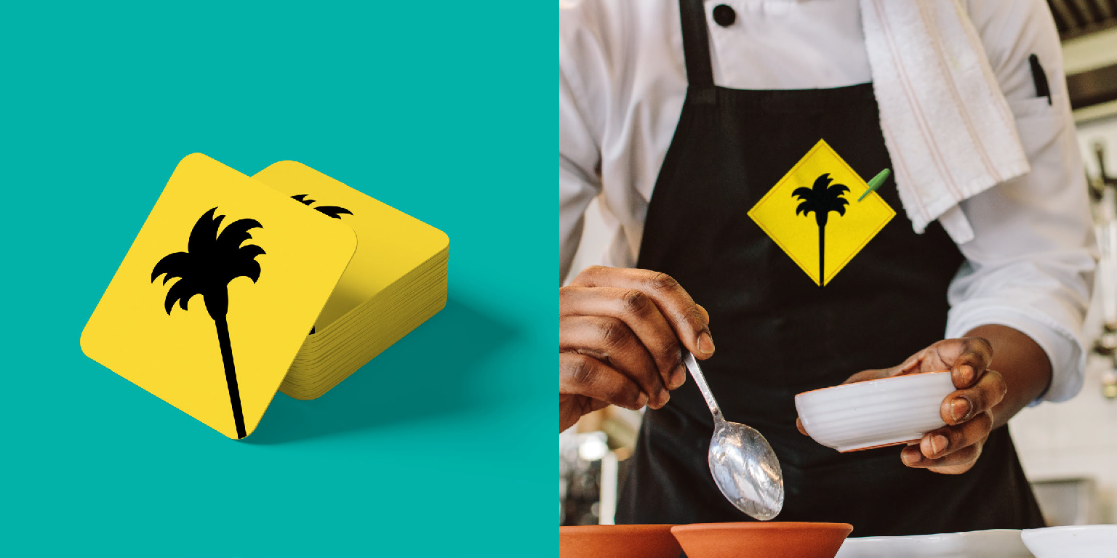
WHY FRANCHISE CPK?
An American Premium Brand
Creative Cali-Fresh Menu with Local Flexibility
Experienced Franchise Support Team
A Brand Uniquely Positioned Among Competition
Full Service, Quick Service, Virtual & Vending Prototypes
USA Number One Brand Image

Slide 12

“ULTIMATELY, WE ARE A PLACE THAT MOVES FOOD, AND PEOPLE, FORWARD”
JOIN OUR FAMILY, BECOME A CALIFORNIA PIZZA KITCHEN FRANCHISEE. CONTACT US:
Carlos De León
Franchise Development Consultant
Mobile: +1 972 489 2753
carlos@deleonfranchising.com
Disclaimer:
All information in this deck is based in US numbers with US laws, cost expectations, building practices, real estate variances operated by CPK Inc. The information and numbers in this presentation do not reflect any anticipated or expected results from a franchisee and are merely used as guidance and should not be misconstrued as projected performance in any country. Countries outside of the US vary in all the aforementioned practices and will reflect the results of CPK in each country differently.

